Slide 1
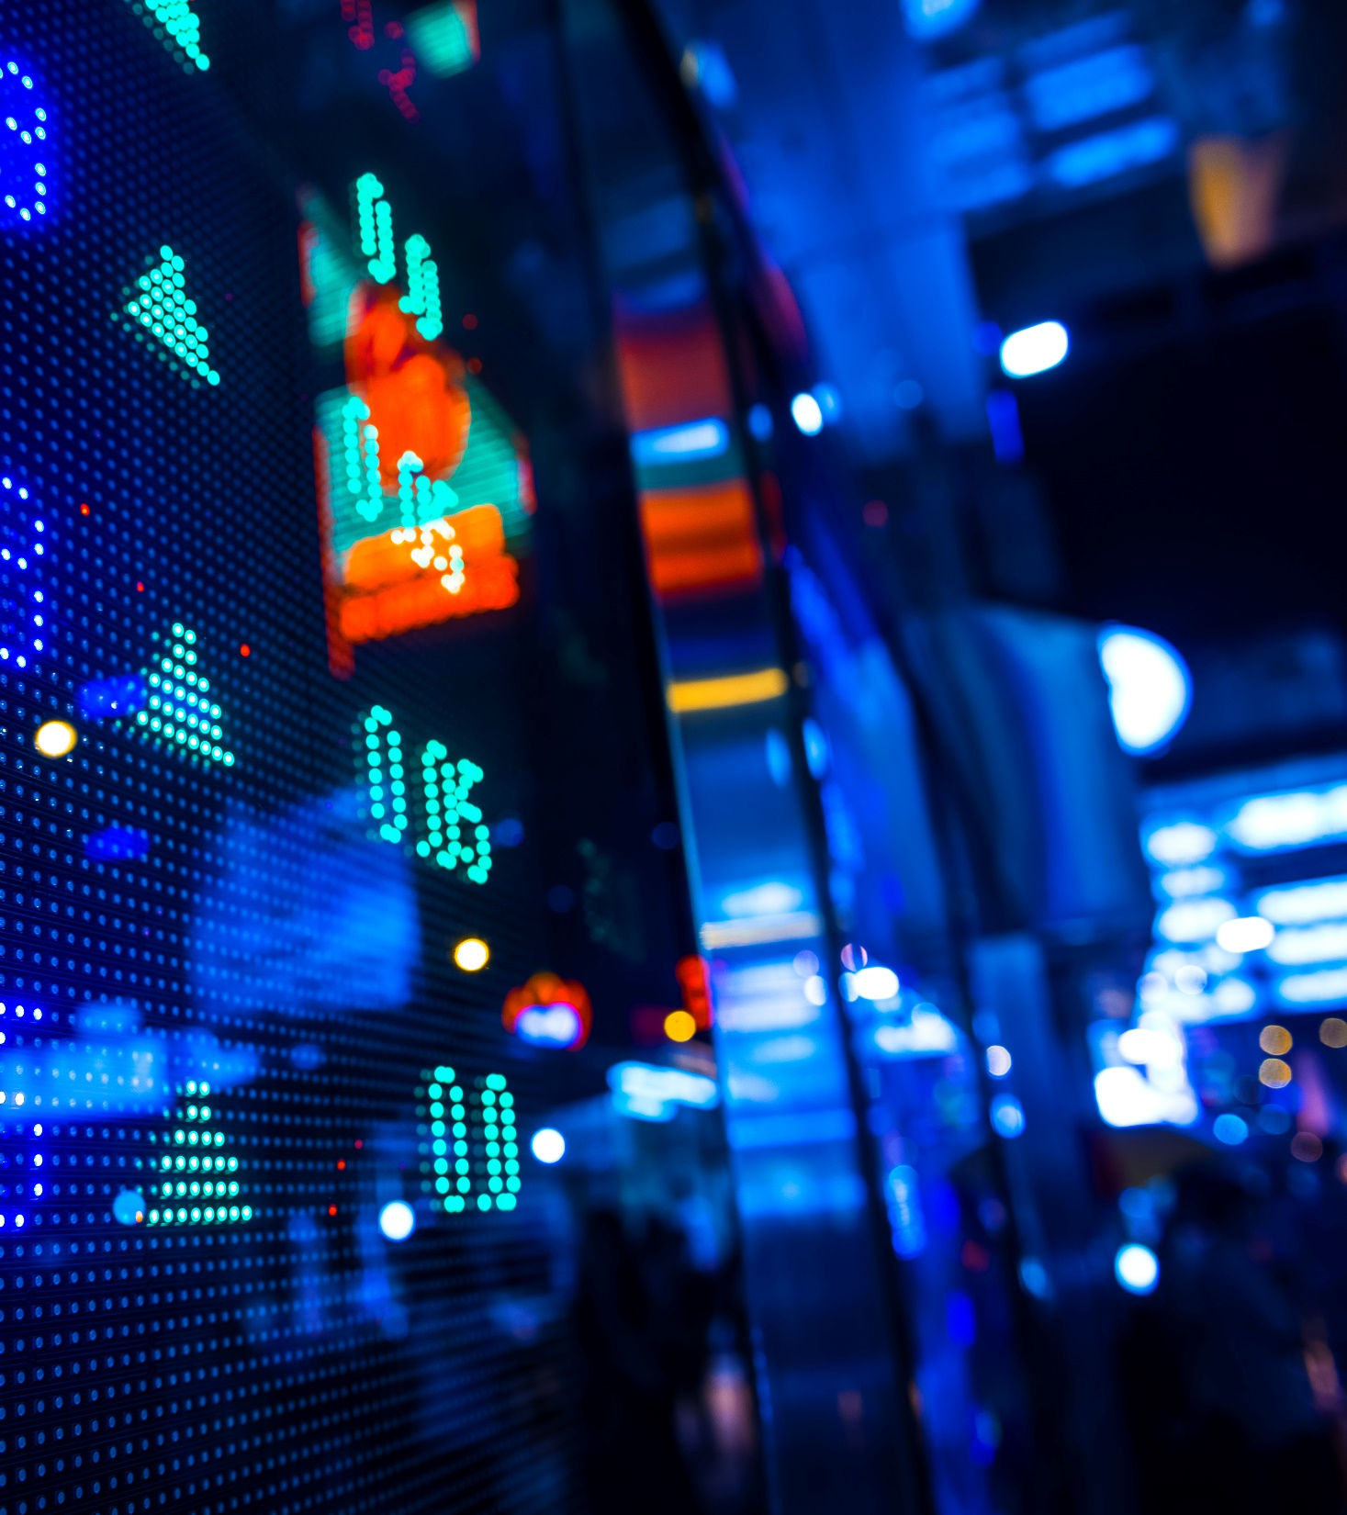
Stock Market Data Analysis
How to Trade: The definitive guide to trading
Presentation By:
Bhavneet Kaur, Seerat Saini,
Taniapreet Kaur, Vancha Omer

Slide 2
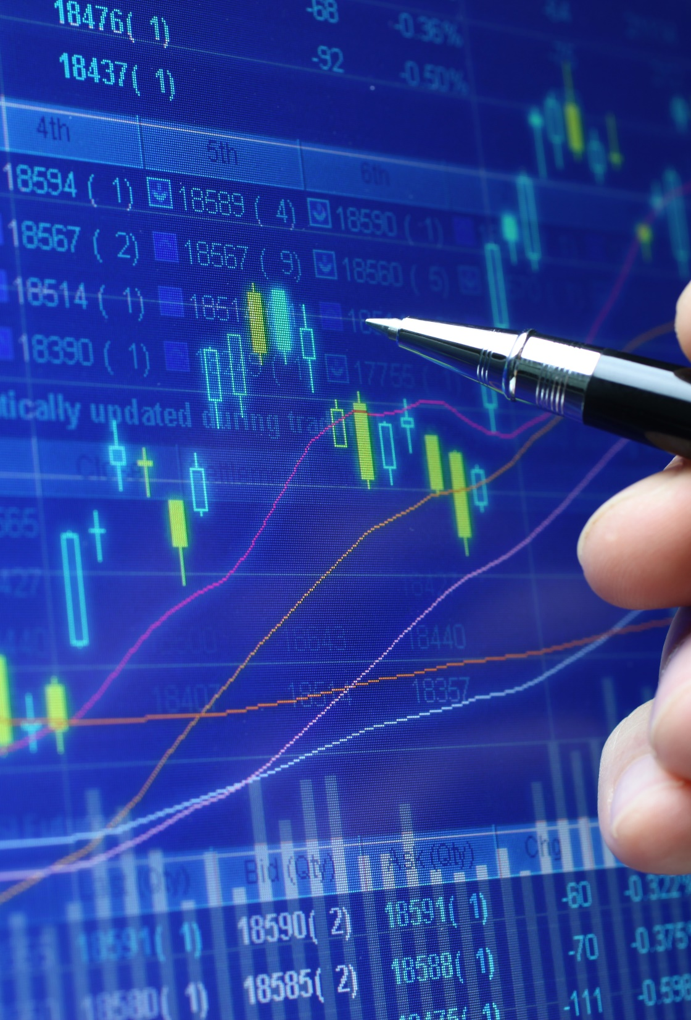
About trading in stock market
Mark Twain once divided the world into two kinds of people: those who have seen the famous Indian monument, the Taj Mahal, and those who haven't. The same could be said about investors.
There are two kinds of people those who understand stocks India and those who don't.
Stocks are but one of many possible ways to invest your hard-earned money. Why choose stocks instead of other options, such as bonds, rare coins, or antique sports cars?
Quite simply, the reason that savvy investors invest in stocks is that they provide the highest potential returns. And over the long term, no other type of investment tends to perform better.
On the downside, stocks tend to be the most volatile investments. This means that the value of stocks can drop in the short term.

Slide 3




GAFA stock prices data Set
GAFA (Google, Apple, Facebook, Amazon) stock prices data set, gives information about the four companies’ performance in the stock market.
Data Source: Yahoo Finance
Data Set Courtesy: Kaggle

Slide 4
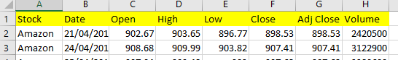
understanding the data set
STOCK: Stocks for the given company.
DATE: The date of trade in stock market.
OPEN: Opening price of the stock for the day.
HIGH: Highest price of the stock for the day.
LOW: Lowest price of the stock for the day.
CLOSE: Closing price of the stock for the day.
ADJUST CLOSE: Adjusted Closing price of the stock for the day.
VOLUME: Volume of stocks traded.

Slide 5
agenda
Project Proposal
Introduction
Objectives
Technologies/Tools Used
How analysis is done
Data Cleaning Using Python
Shell Programming, Pig, Hive
Visualization using tableau
Understanding Candlesticks
Understanding Bollinger Bands
Studying Volume Variation
Result
References

Slide 6
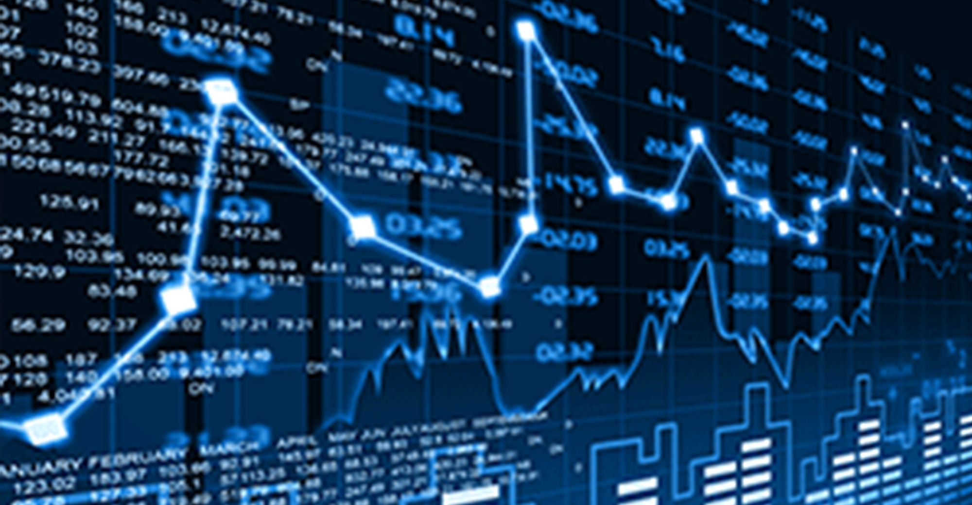
Project proposal
Stock market is very vast and difficult to understand. It’s considered too uncertain, due to high fluctuation of the market.
Investing in a good stock but at a bad time can have a disadvantageous result, while an investment at the right time can bear fruitful results. Financial investors of today are facing this problem of trading as they don’t understand the market well.
So with our project, we aim to reduce the problem of investors, who have a tough time analyzing/ understanding trends.

Slide 7
introduction
Stock market data of various companies is analysed with the help of shell scripts that run on Hadoop cluster which tells us about the company’s current position in the market and various other factors.
The process of analysing is made automated with the help of shell scripts in which analysing queries are pre-written.
One can easily have a market watch for any day he/she wants to look at FY 2017-18. This project aims at providing simple and easy analysis of various Stocks as per the user's requirement.

Slide 8
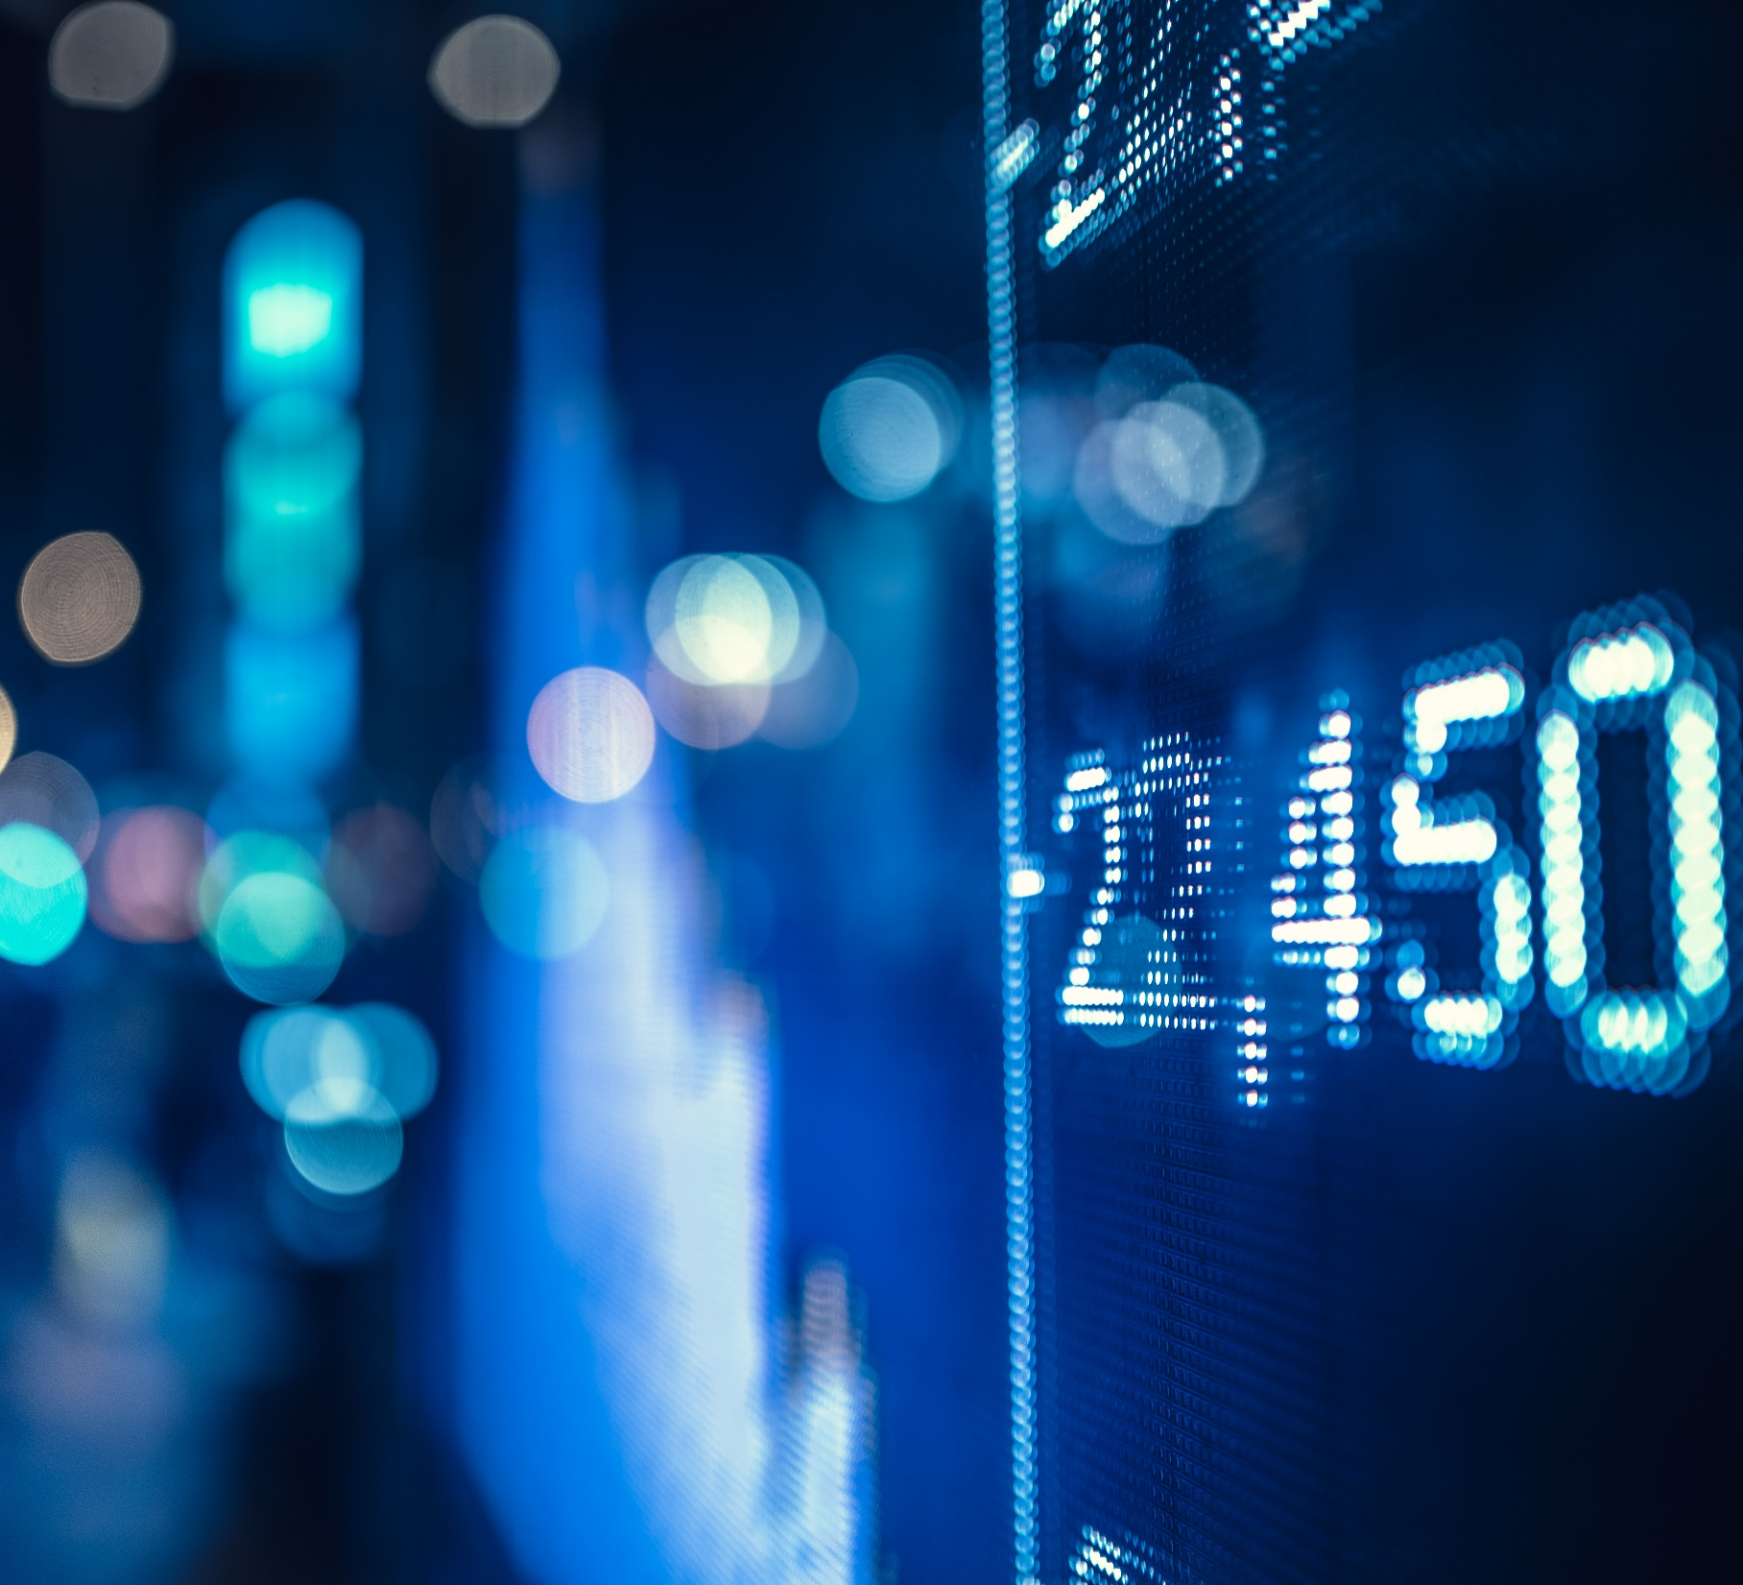
Objectives
1. Percentage Change
2. Gain Per Day
3. Loss Per Day
4. Average Gain & Average Loss
5. Moving Average
6. Variance of Adjust Close
7. Standard Deviation of Adjust Close
8. Relative Strength
9. Relative Strength Index
10. Average Trading Volume

Slide 9
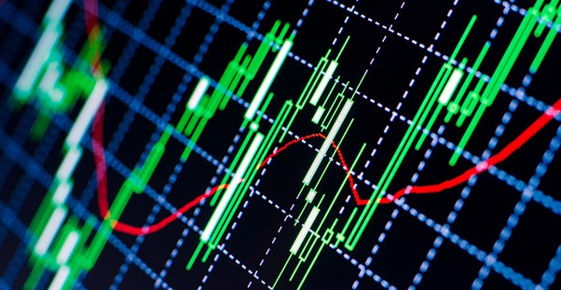






TECHNOLOGIES USED
PYTHON
HADOOP FRAMEWORK
PIG
HIVE
TABLEAU
SHELL PROGRAMMING

Slide 10
How analysis is done
Stock market data is saved as .csv file which is comma separated file, which is then uploaded to hdfs.
Data is then checked for any null values with the help of python.
Then it is loaded for query execution in pig.
Data is also loaded into hive using hive commands, mappers, etc.
Analysing queries are then applied on this data which finally gives us information.
The scripts become automated with the help of shell programming.
Data is visualized with the help of tableau, using various charts such as candlesticks, Bollinger bands etc.

Slide 11
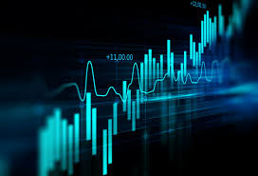
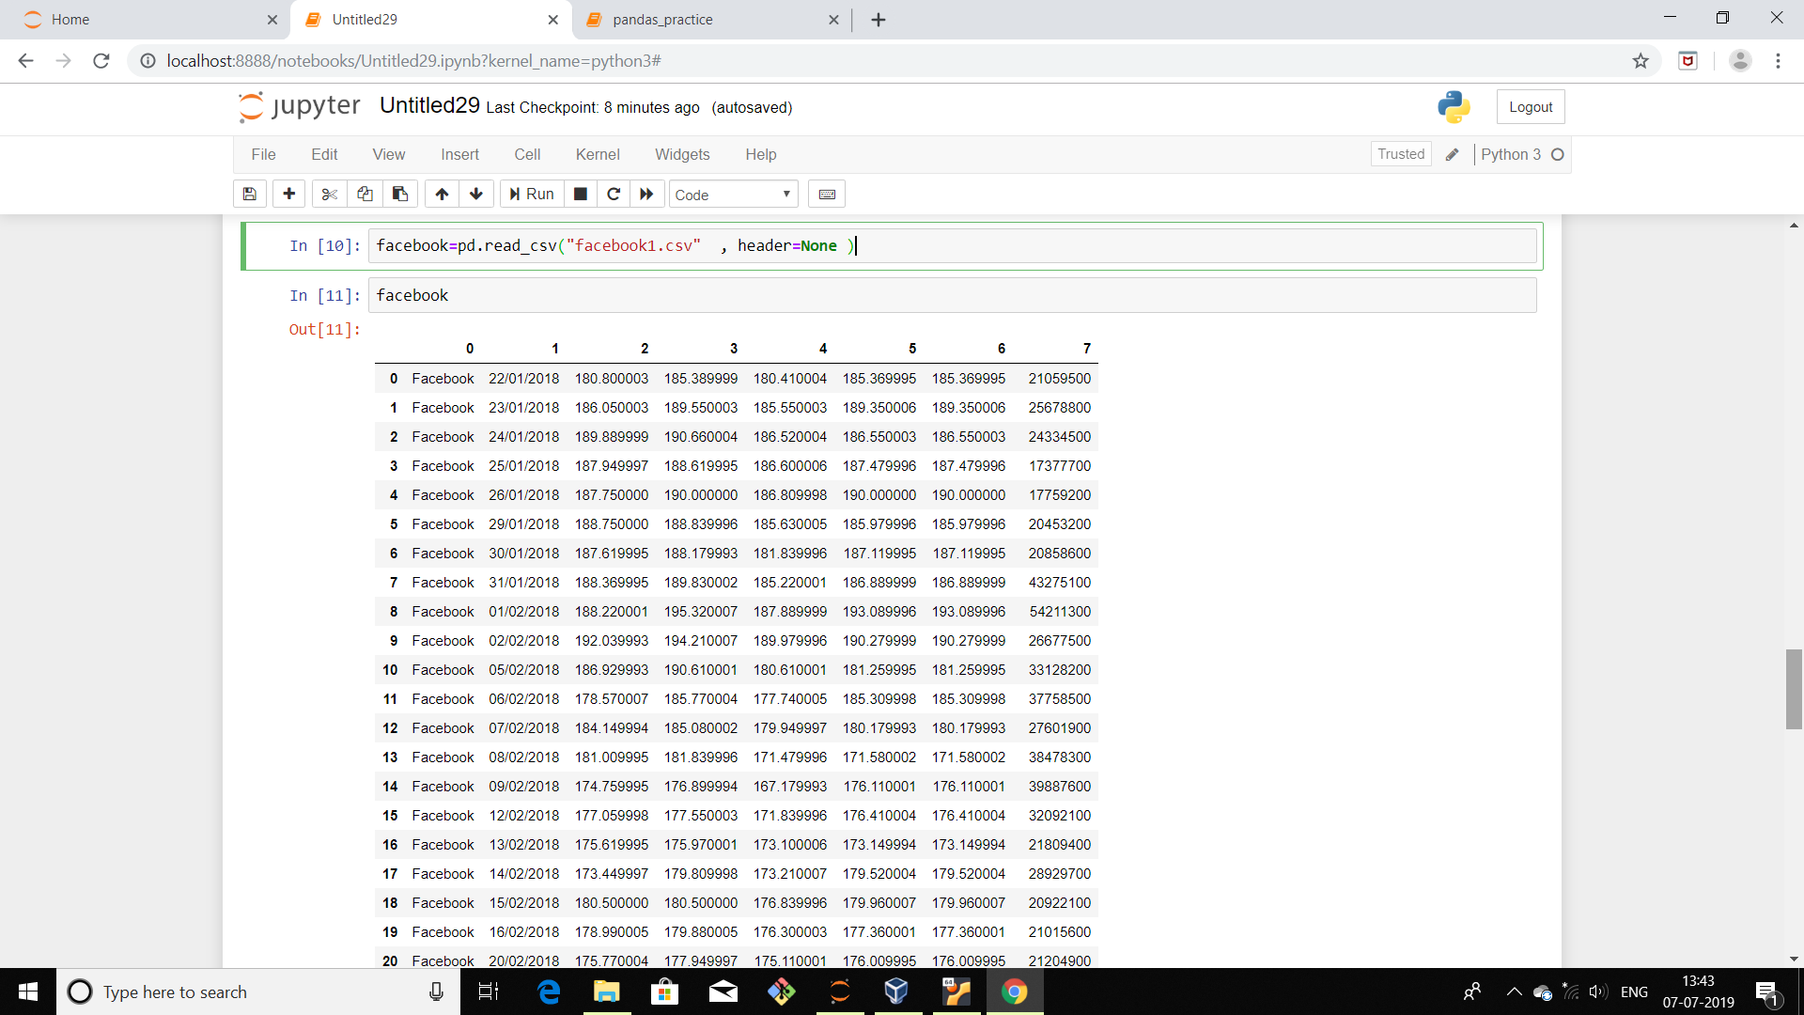
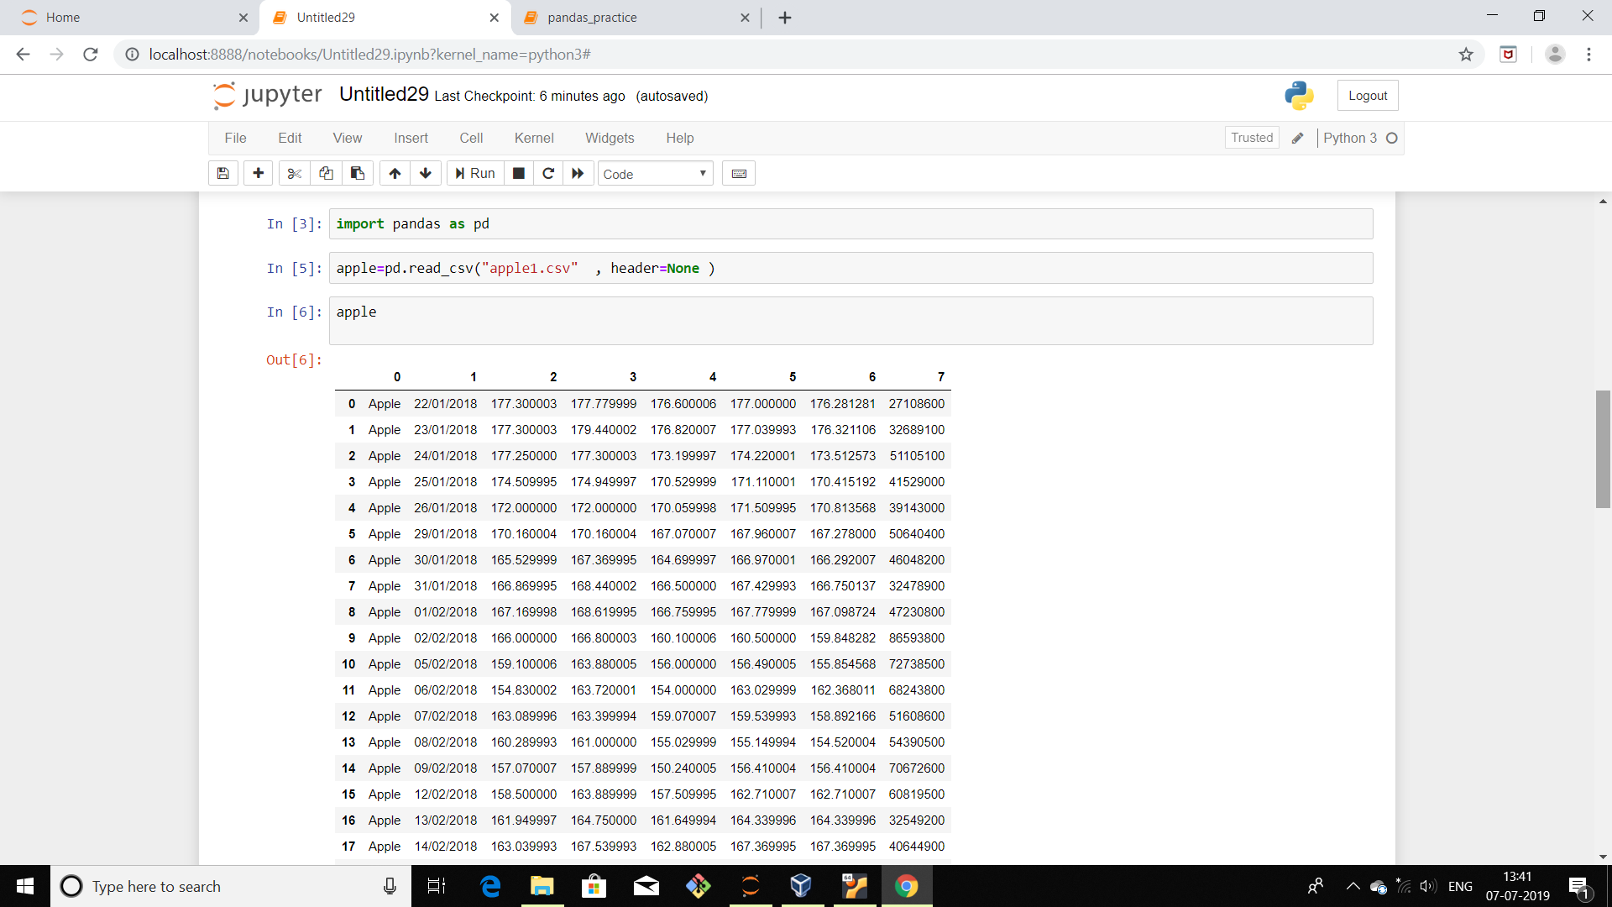

Data cleaning using python
Using pandas read the data set.

Slide 12
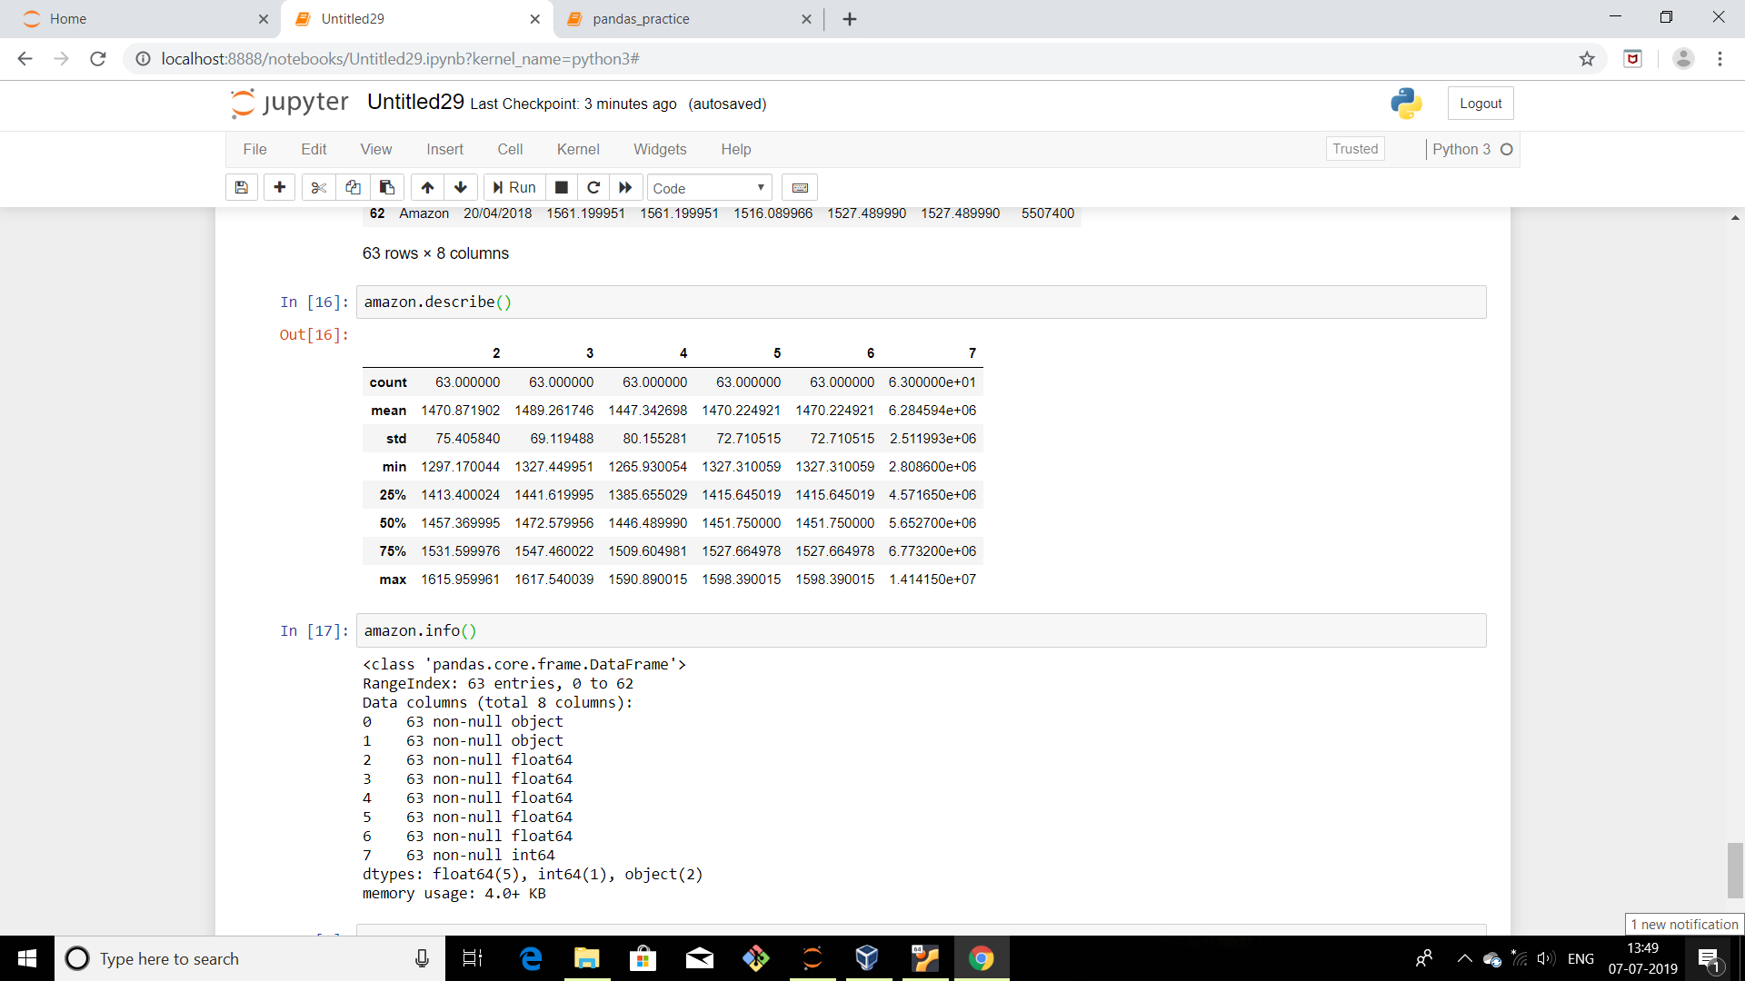
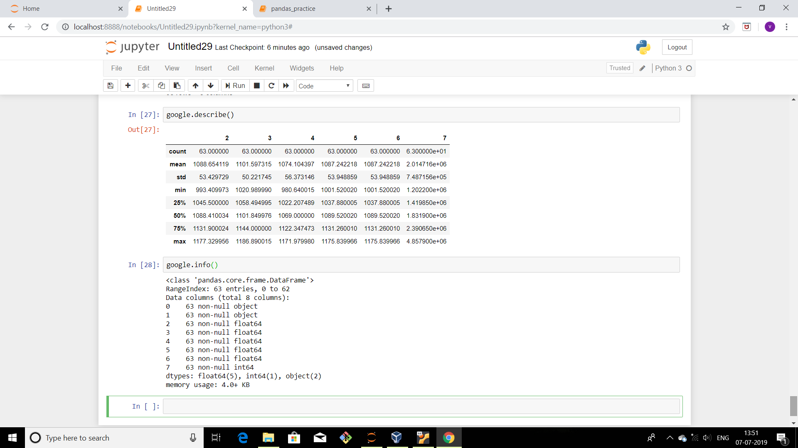
Using .describe() and .info() to check for the statistical data and for any null value if present.

Slide 13
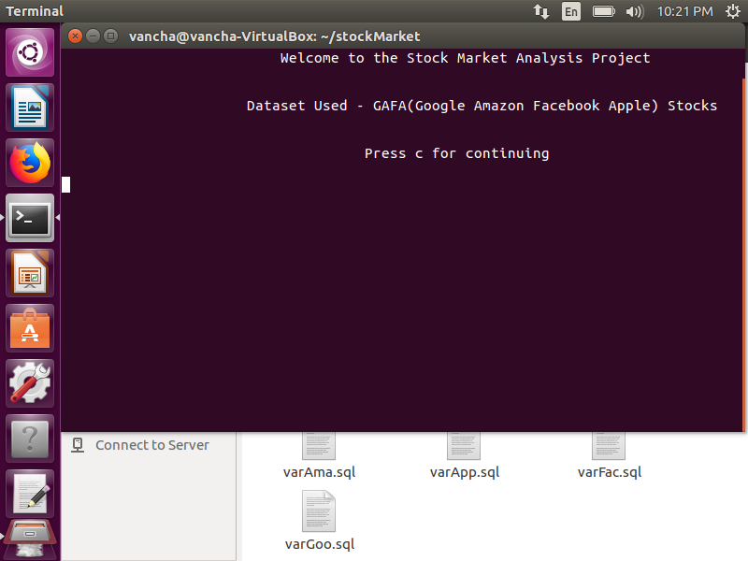


Using shell programming to automate pig, hive queries

Slide 14
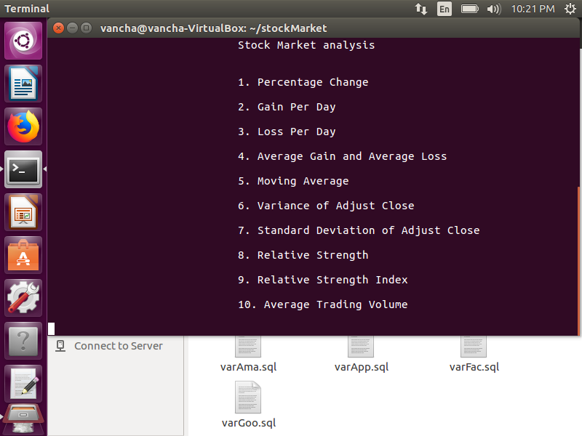
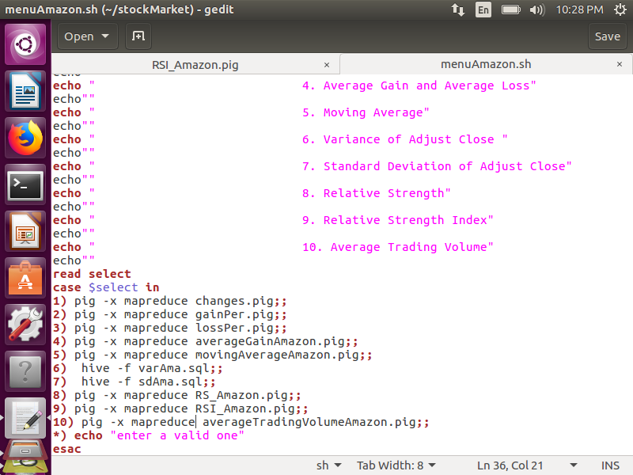
SHELL PROGRAMMING

Slide 15
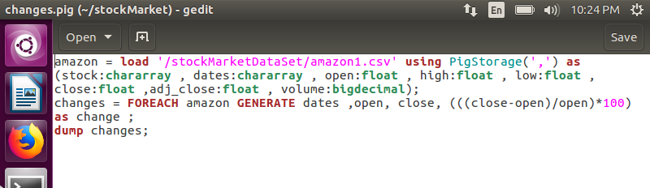
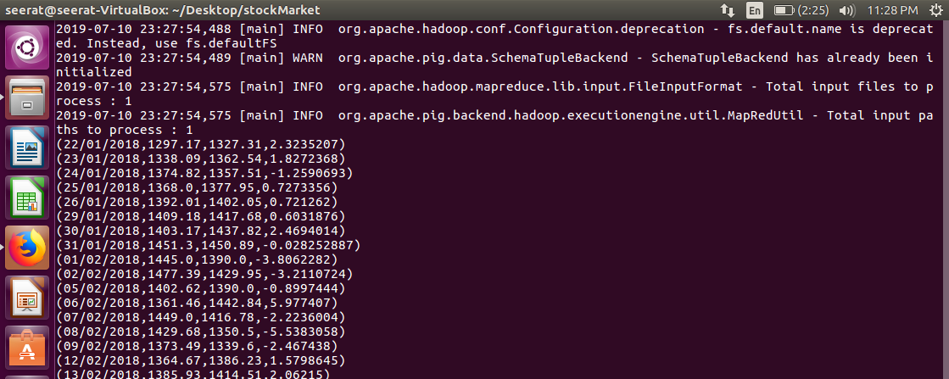
PIG Query Execution

Slide 16
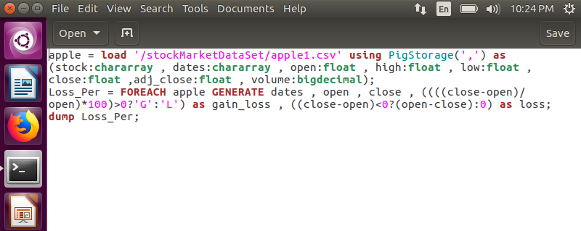
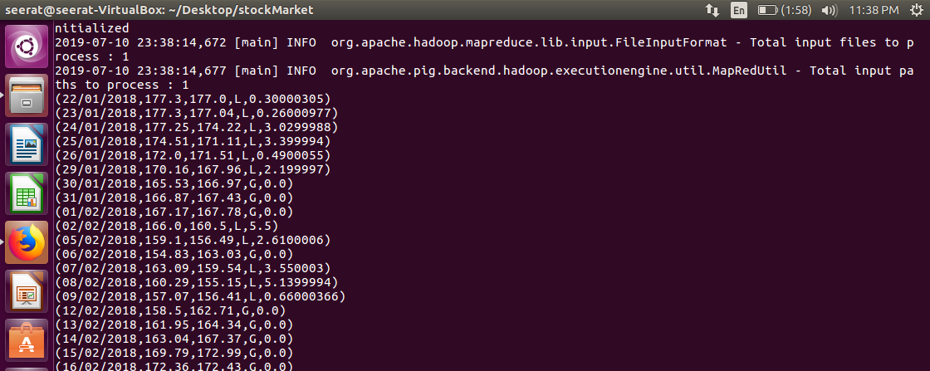

Slide 17
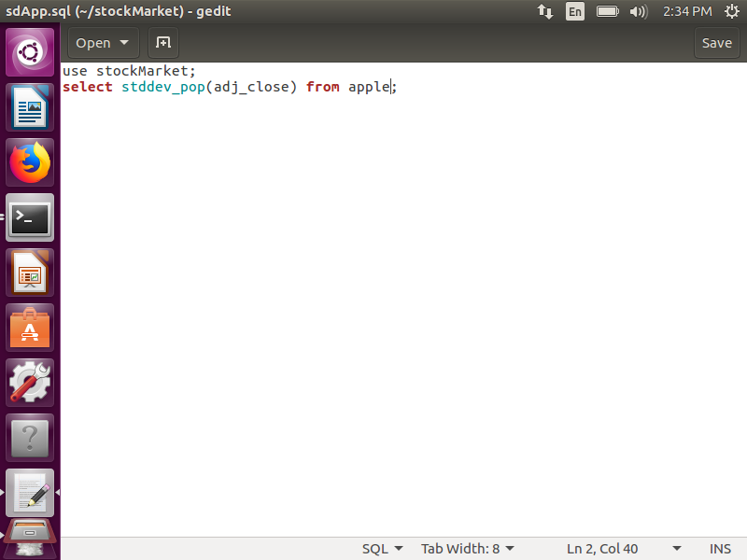
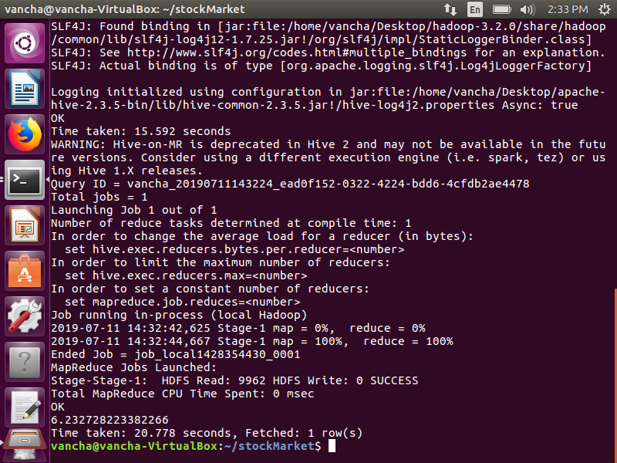
Hive Query Execution

Slide 18

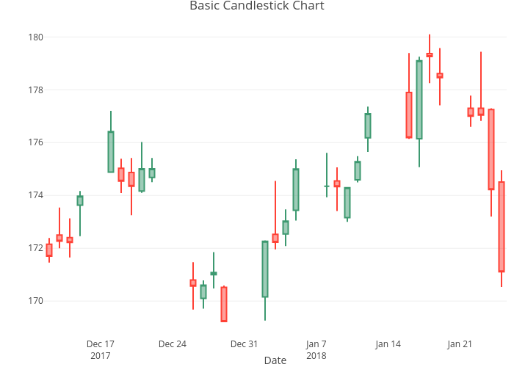
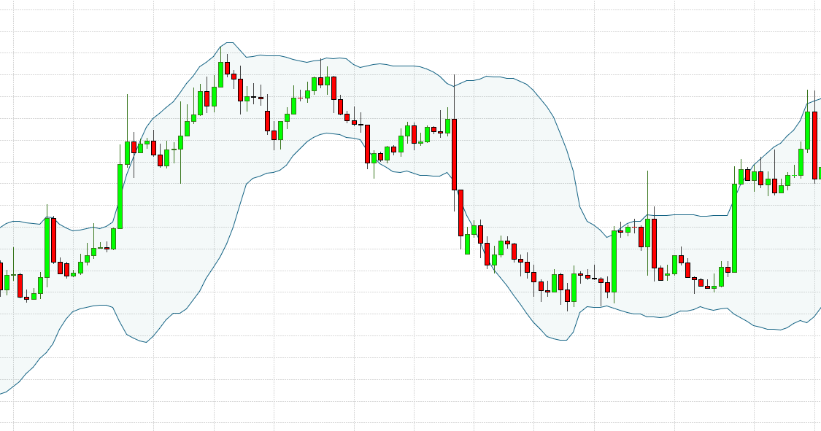
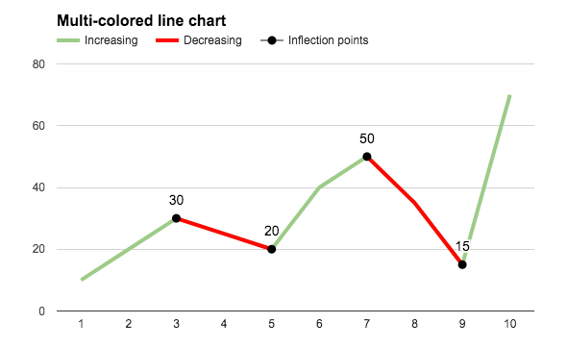
Visualization
Using Tableau
Visualization is done with the help of three charts for each company:
Candlesticks
Bollinger Bands
Line charts

Slide 19
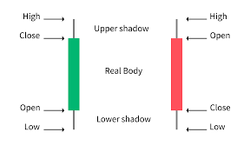
About Candlesticks
Bullish Candles
A candlestick is a type of price chart used that displays the high, low, open, and closing prices of a security for a specific period.
The wide part of the candlestick is called the "real body" and tells investors whether the closing price was higher or lower than the opening price (red if the stock closed lower, green if the stock closed higher).
Bearish Candles

Slide 20
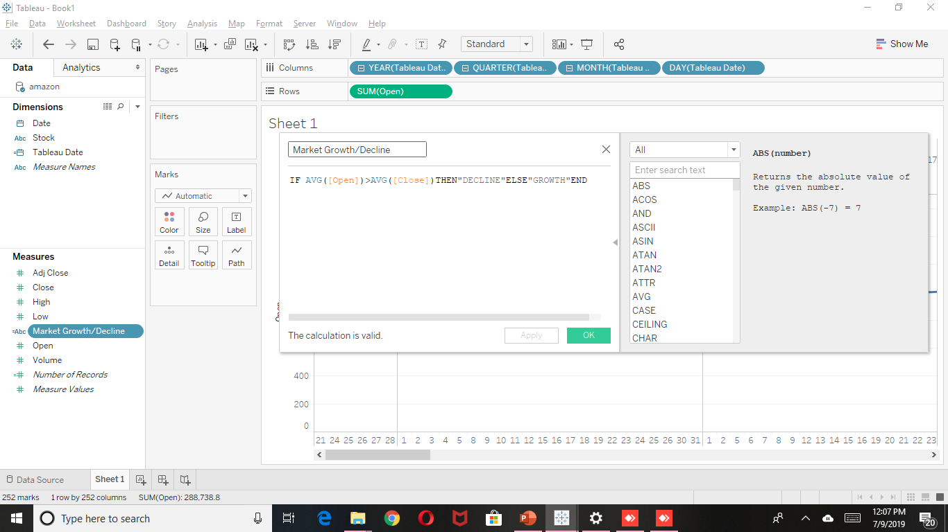
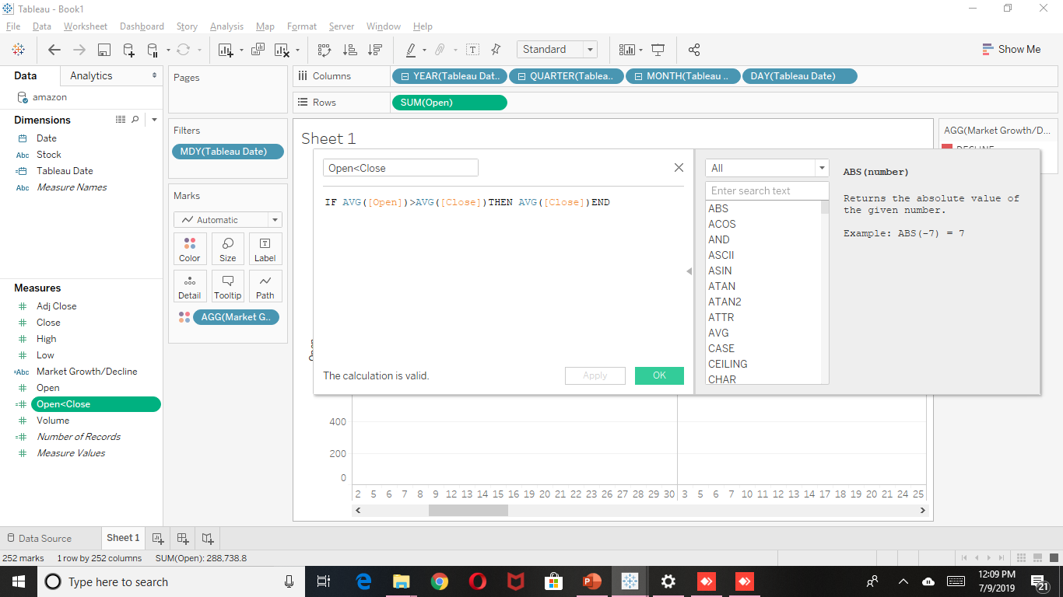
Creating Candlesticks
Creating three calculated fields, for:
Market Growth/Decline
Open price > Close Price
Close Price > Open Price

Slide 21
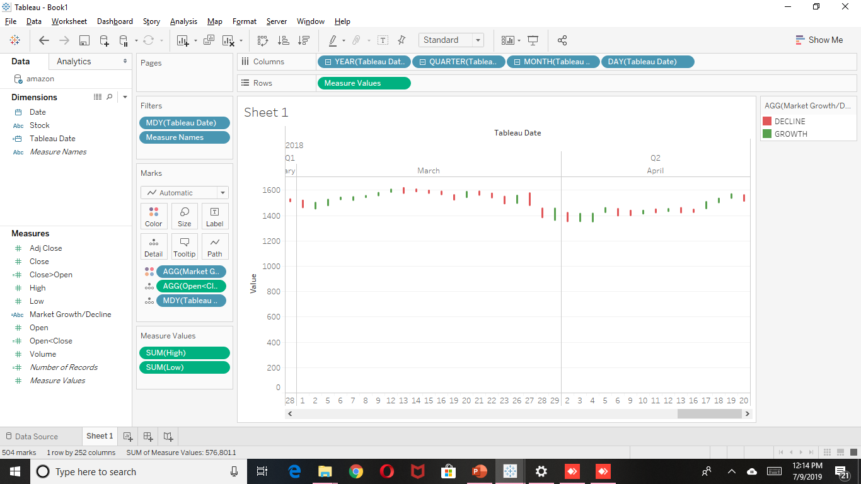
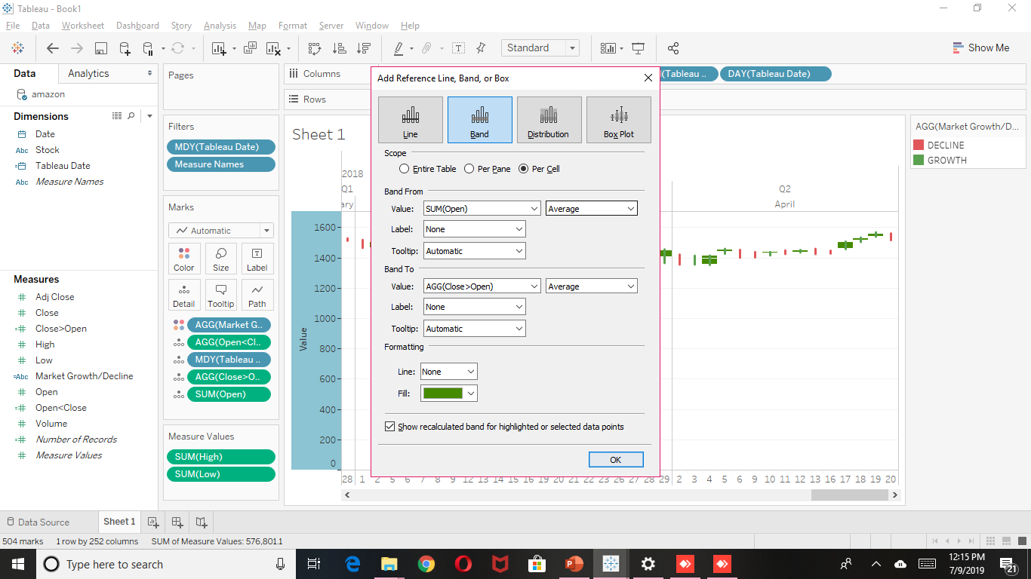
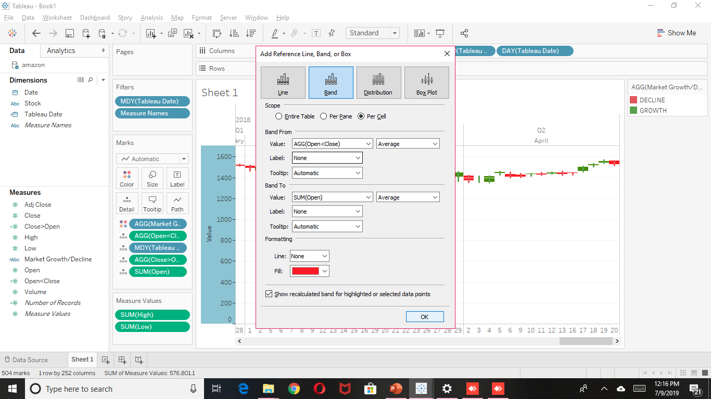
Banding the candles in colors relative to market growth and decline.

Slide 22
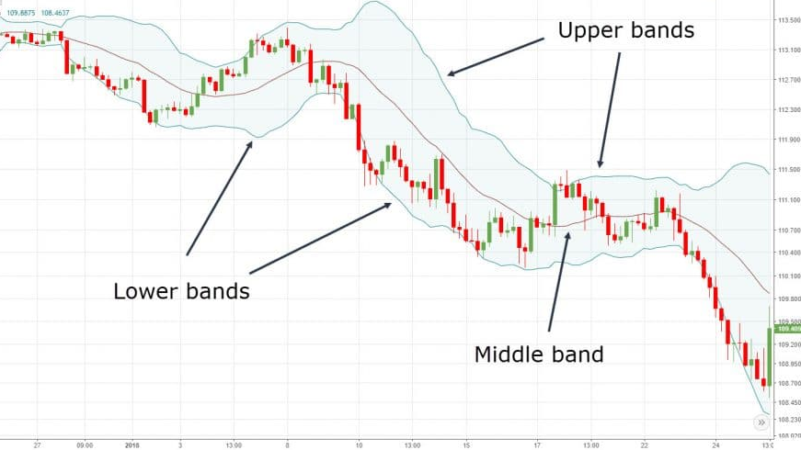
Bollinger bands
Bollinger Bands is one of the popular technical analysis tools, where three different lines are drawn, with one below and one above the security price line.
Its specific period moving average is denoted as midline to form an ‘envelope’. These lines show a band or a volatility range in which a particular security price is moving up or down. Volatility is shown on the basis of standard deviation for a particular security, which is denoted by upper and lower line/band, as standard deviation is a measure of volatility.

Slide 23
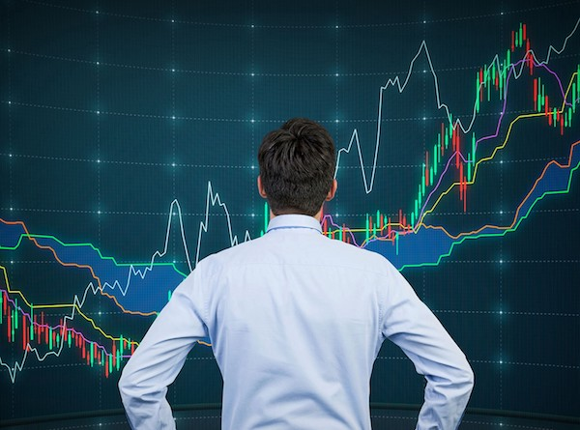
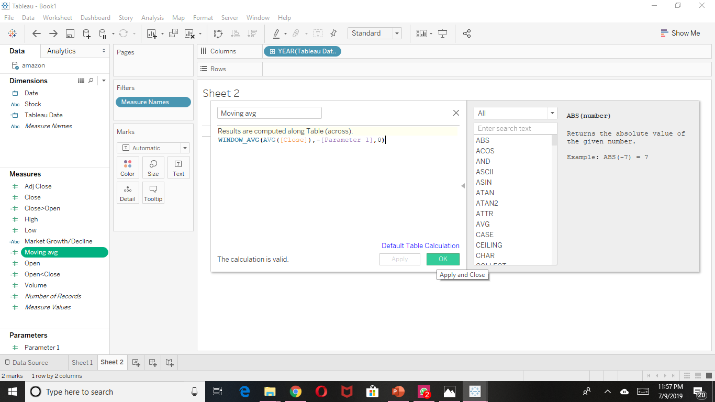
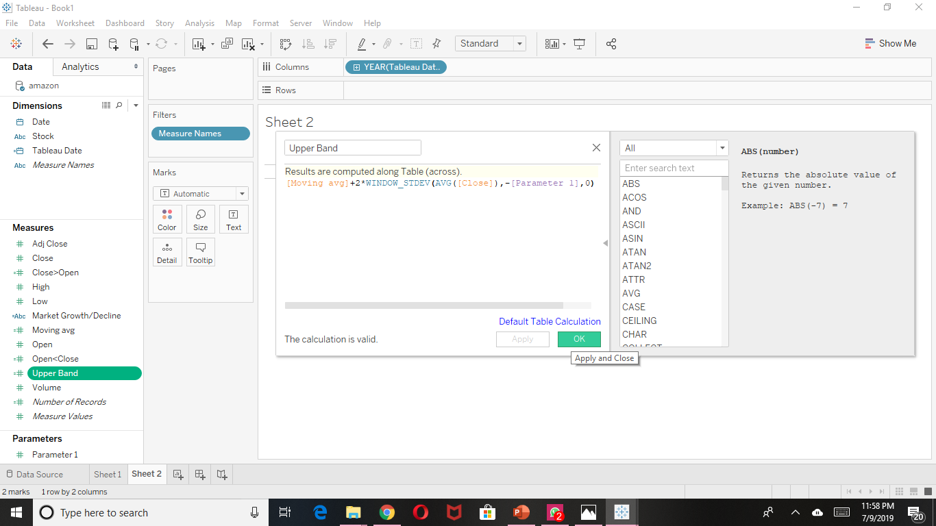
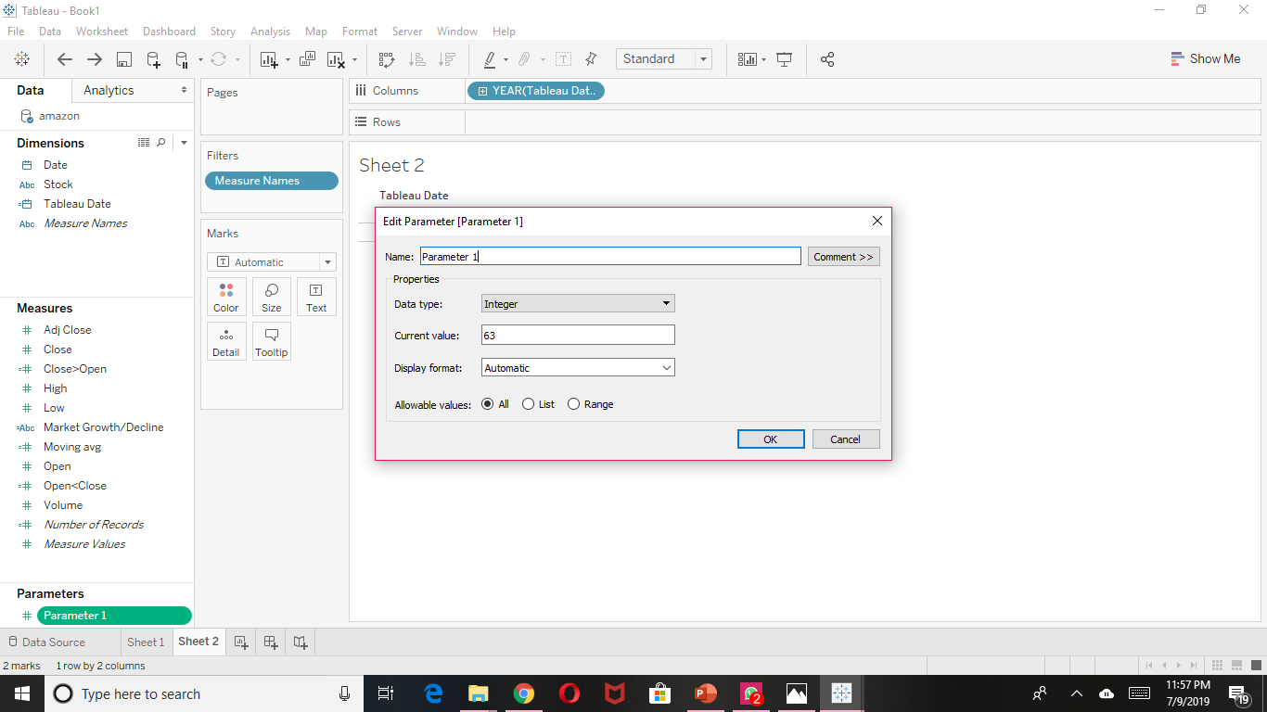
Creating
Bollinger bands
Creating three calculated fields, for:
Moving Average
Upper Band
Lower Band
With a parameter to set the number of days for calculating moving average.

Slide 24
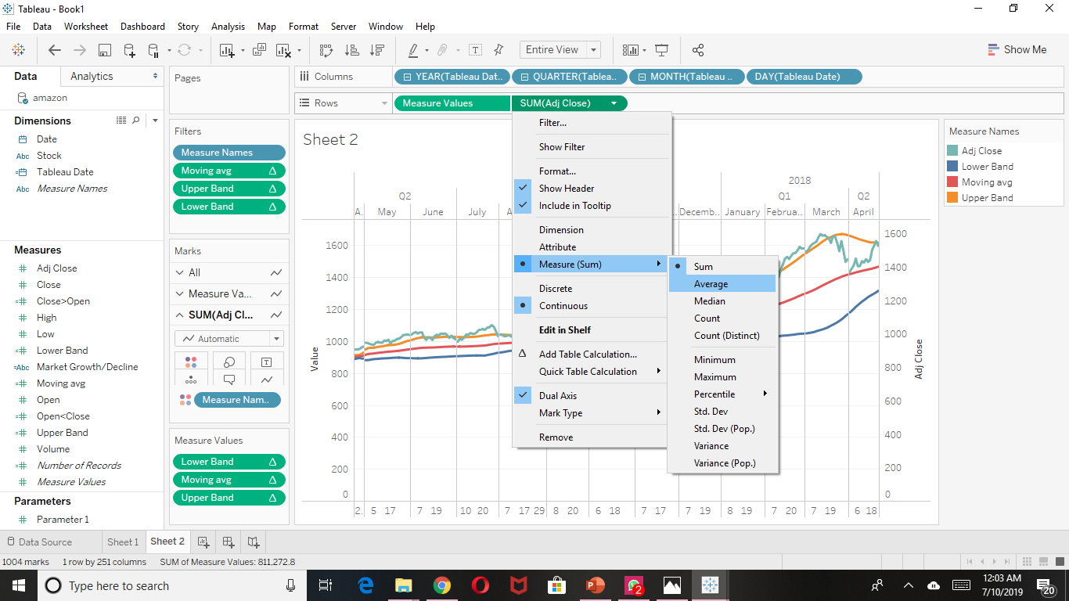
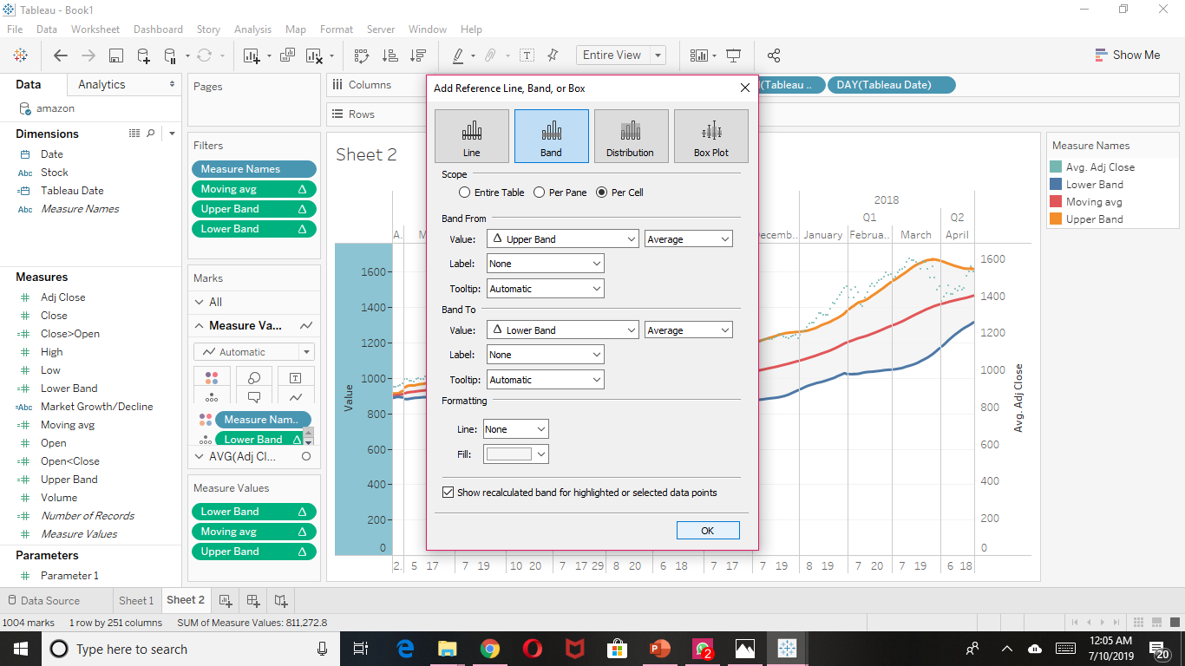
Adding Average adjusted closing price to the chart.
Banding the bounds per cell,
to define the areas.

Slide 25
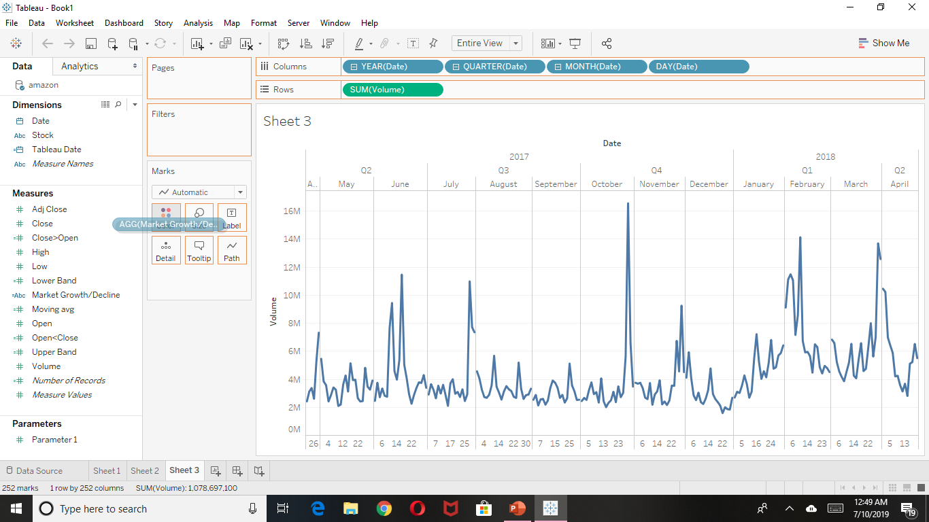
Volume Variation line charts

Slide 26
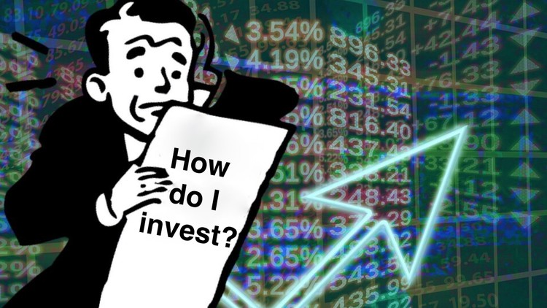
Analyzing Our Charts

Slide 27
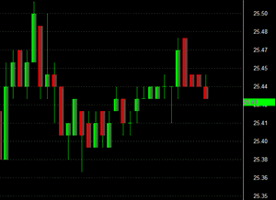
Analyzing Candlesticks using TAE Framework
T: Trend
A: Area of resistance
E: Entry Trigger

Slide 28
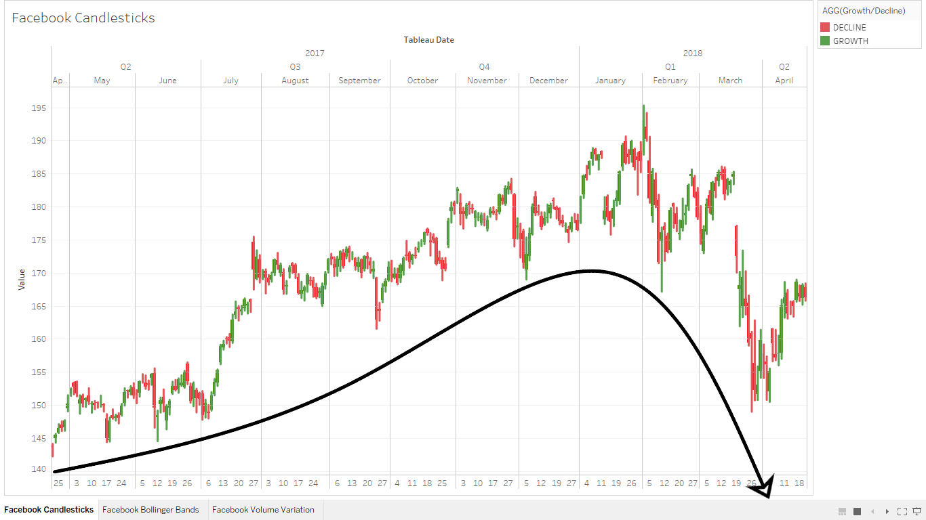
Facebook candlesticks

Slide 29
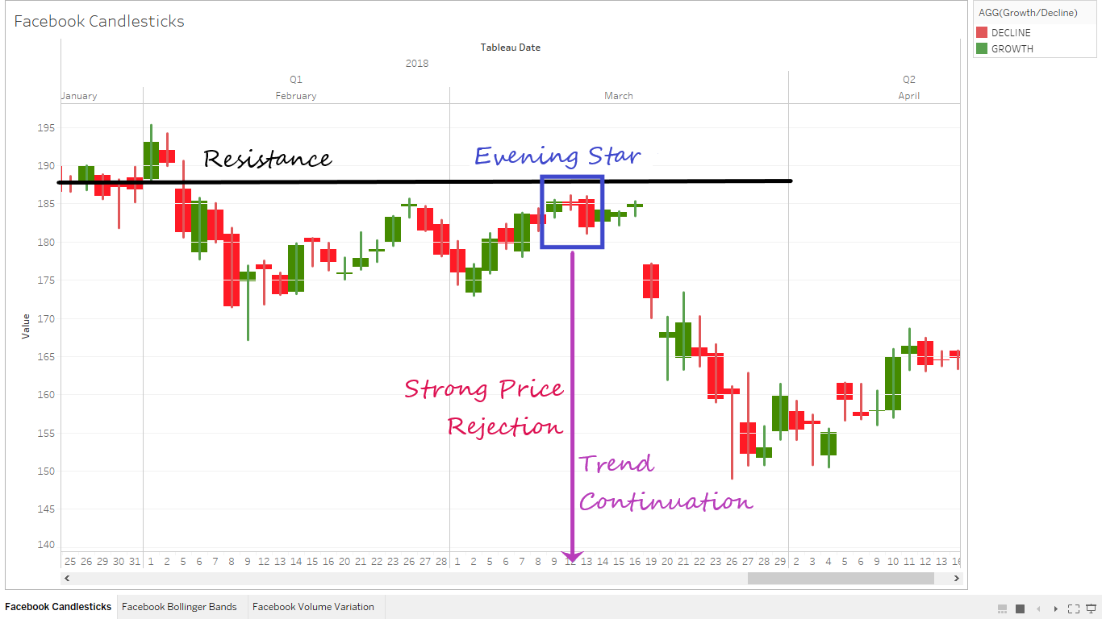
Strong downfall

Slide 30
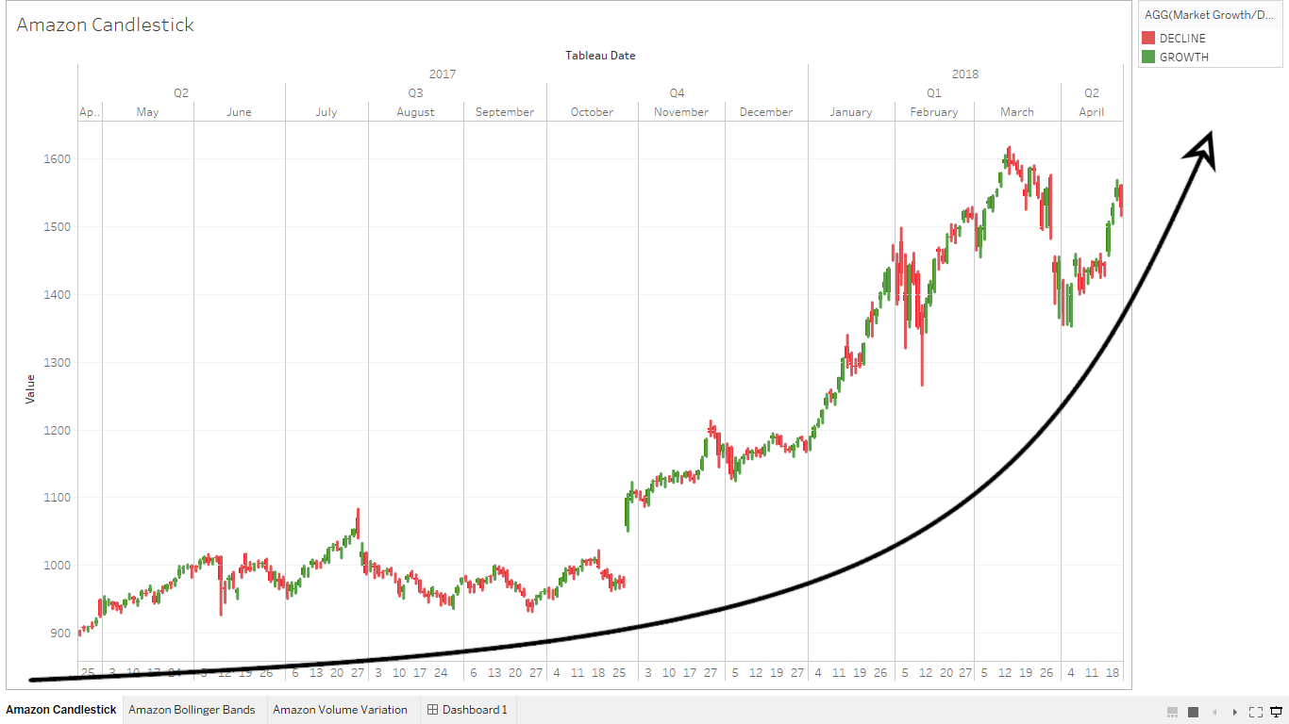
amazon candlesticks

Slide 31
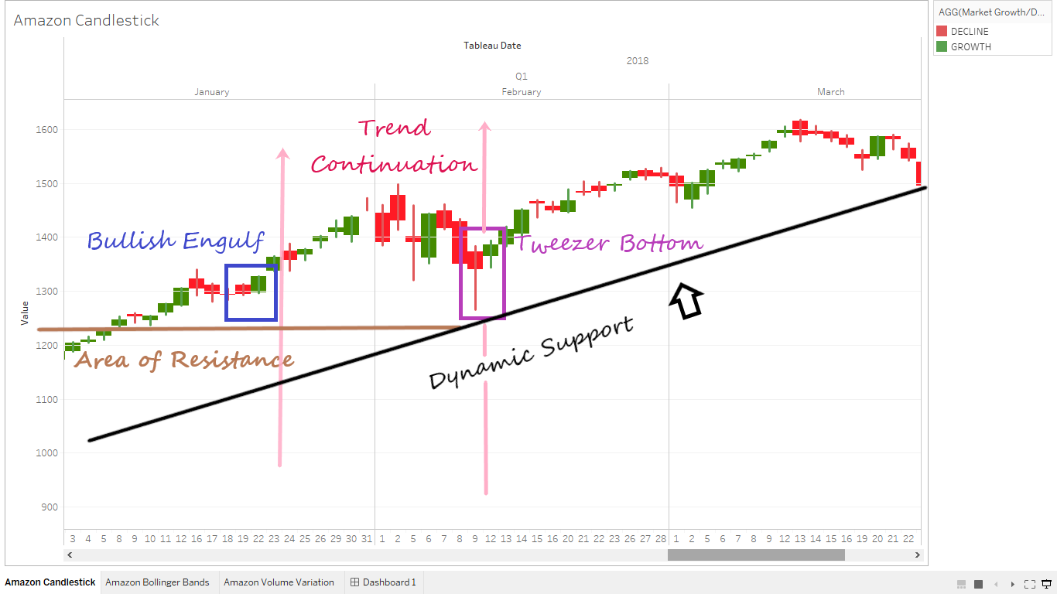
Strong uptrend

Slide 32
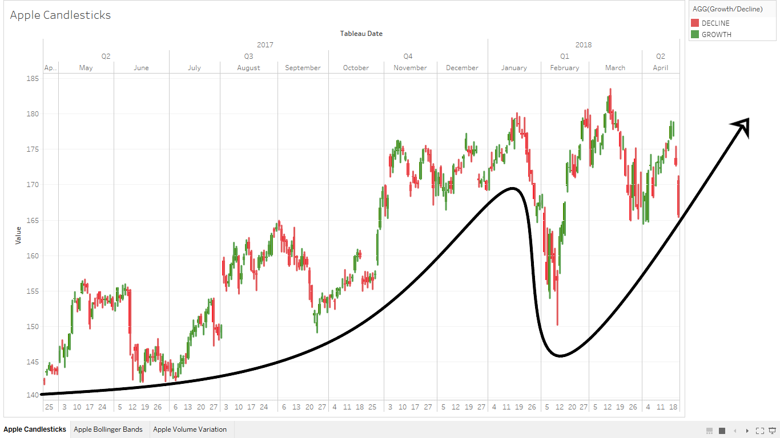
apple candlesticks

Slide 33
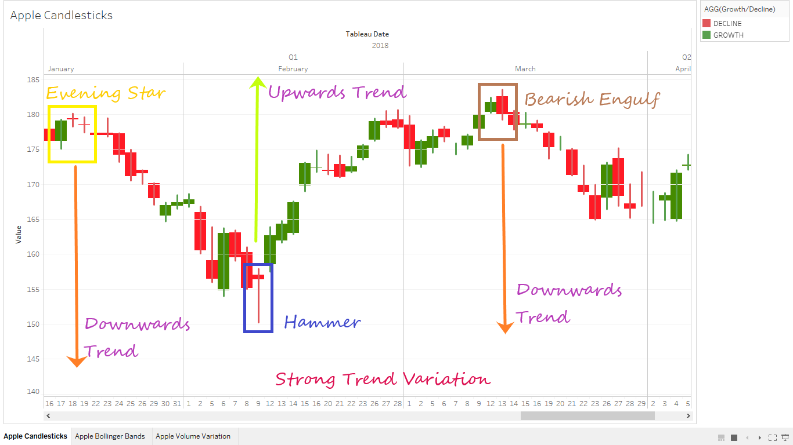
Strong Variation

Slide 34
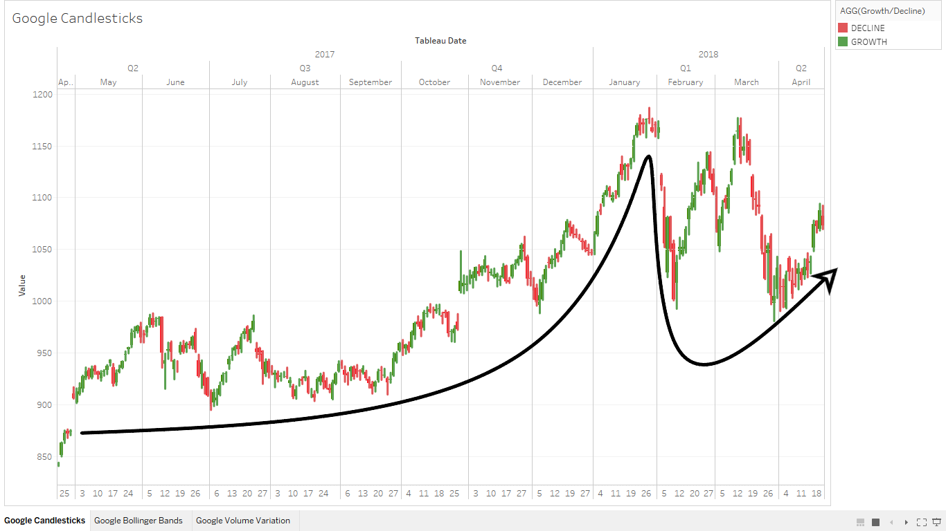
Google candlesticks

Slide 35
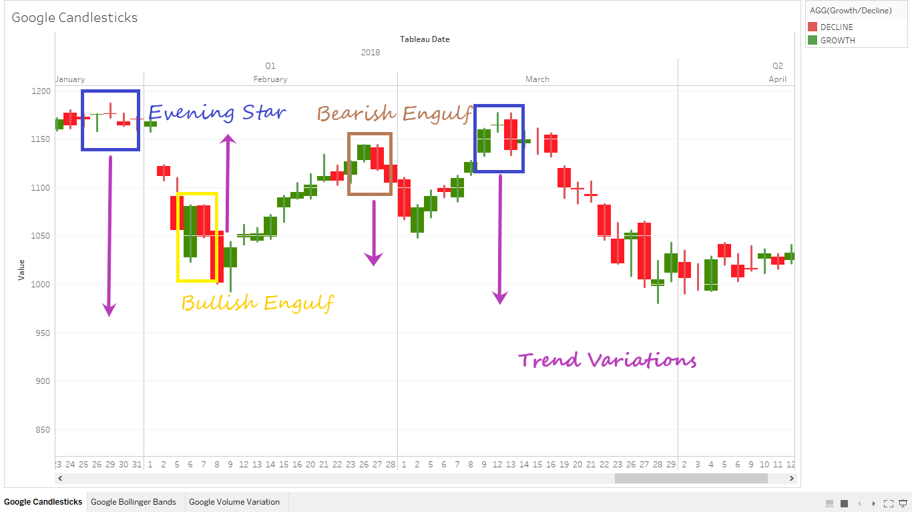
Inconsistency in stocks

Slide 36
Analysis Using
Bollinger bands

Slide 37
Need to know
When to Buy
When to Sell
When to Hold

Slide 38
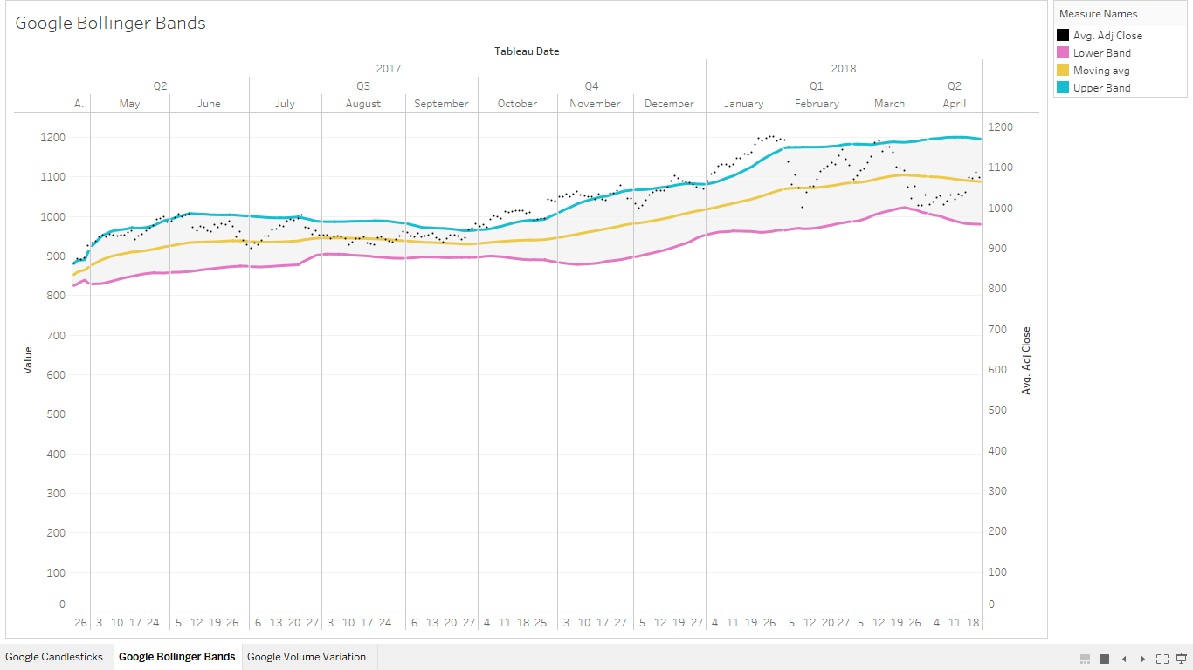

Slide 39
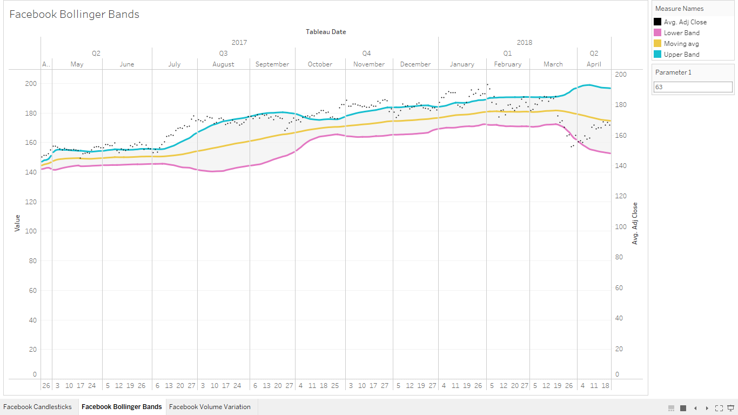

Slide 40
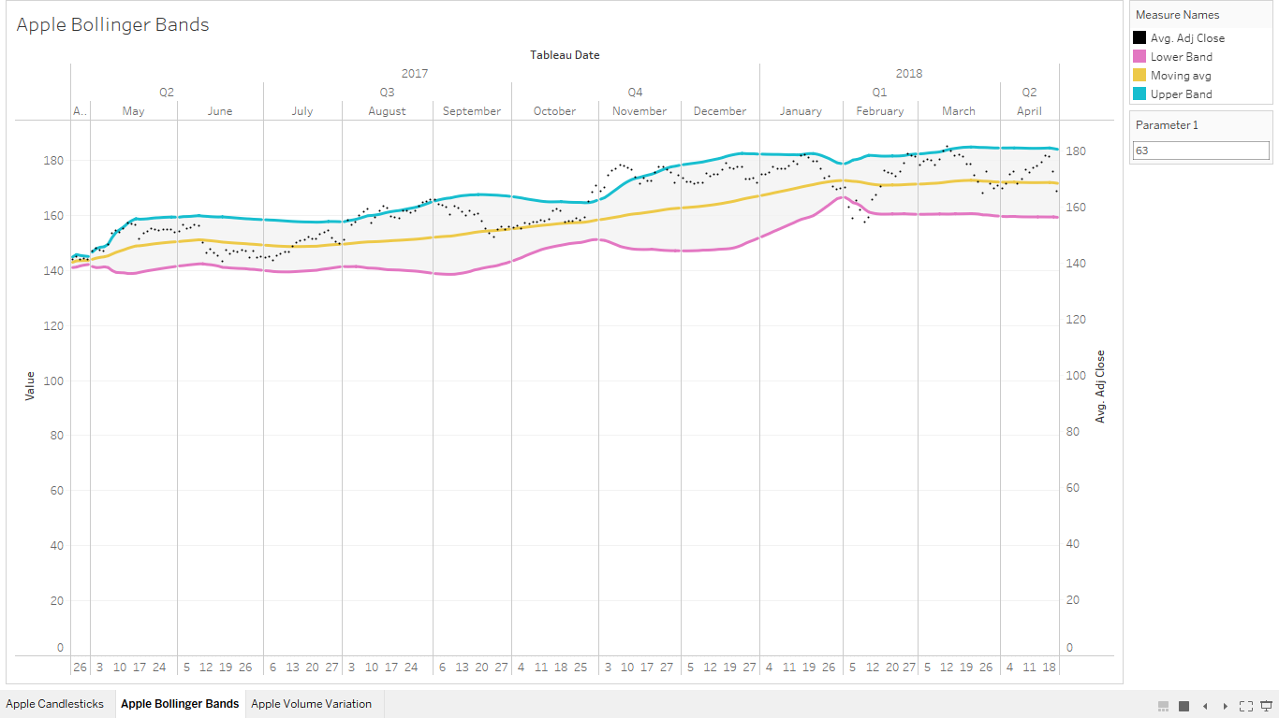

Slide 41


Slide 42

Which company to invest in?
Let’s try to understand the volume variation for all four stocks, to analyze the best performing stock

Slide 43






Slide 44




Can you tell
who was the most grossing?
Or
Who was the most stable?

Slide 45


Slide 46

Most grossing stock:
Facebook
Most stable stock:
Google

Slide 47
Result
From candlesticks we can analyze the trends in advance, weather the market will fall or rise, or will the stock remain steady.
From Bollinger bands we can understand whether the time is right to invest, sell or hold.
For conclusive measures, we can judge from line charts what we are looking for.

Slide 48
References
https://www.youtube.com/watch?v=5shuZuIMR6k
https://www.youtube.com/watch?v=C3KRwfj9F8Q&t=3s
https://www.youtube.com/watch?v=KxlUFKPCxeg&t=21s
https://community.tableau.com/blogs/singh.rahul/2017/05/03/candlestick-charts-in-tableau
https://www.tableau.com/learn/tutorials/on-demand/candlestick-charts-and-bollinger-bands?product=tableau_desktop&version=7_0&topic=advanced
https://www.fidelity.com/learning-center/trading-investing/technical-analysis/technical-indicator-guide/RSI
https://www.investopedia.com/terms/s/standarddeviation.asp

Slide 49

Thank you

